Slide 1

EVENT SUCCESS: DATA-DRIVEN DASHBOARDS FOR GROWTH

Slide 2


PROBLEM STATEMENT
OBJECTIVE:
UNLOCKING THE POWER OF EVENTS: TRANSFORMING MARKETING DATA INTO GROWTH STRATEGIES
KEY CHALLENGES:
FRAGMENTED DATA: SCATTERED ACROSS MULTIPLE SOURCES.
Manual Processes: Inefficient and PRONE TO ERRORS.
LIMITED INSIGHTS: DIFFICULTY IDENTIFYING SUCCESSFUL STRATEGIES.
3

Slide 3


PROJECT DELIVERABLES
AUTOMATED USER INTERFACE:
STREAMLIT UI: ALLOWS THE CLIENT TO UPLOAD FILES DIRECTLY.
AUTOMATED PROCESSING: STREAMLINES DATA CLEANING, VALIDATION, AND CONSOLIDATION, REDUCING MANUAL EFFORT AND IMPROVING EFFICIENCY.
INTEGRATED DATASET:
MERGE DATA FROM MULTIPLE DATA SOURCES INTO A SINGLE UNIFIED DATASET.
4

Slide 4


PROJECT DELIVERABLES
INTERACTIVE DASHBOARDS TO ADDRESS KEY BUSINESS QUESTIONS:
KEY QUESTIONS:
EVENT SUCCESS BY SCHOOL
OUTREACH ENGAGEMENT IMPACT
GROWTH OFFICER CONTRIBUTION
FOLLOW-UP COMPLIANCE
ACTIONABLE RECOMMENDATIONS:
INSIGHTS TO IMPROVE FUTURE EVENT PLANNING AND MARKETING.
5

Slide 5




THE DATA PUZZLE
WE WERE PROVIDED WITH FOUR FILES, EACH WITH UNIQUE INFORMATION.
SUBMITTED APPLICATIONS
APPROVED
APPLICATIONS
MEMBER OUTREACH
EVENT DEBRIEF OR SPONSORSHIP
INCLUDES ALL SUBMITTED APPLICATIONS, REGARDLESS OF STATUS.
LISTS APPLICATIONS THAT MET ALL REQUIREMENTS.
TRACKS ALL MEMBERS CONTACTS BY GROWTH OFFICERS.
DOCUMENTS ALL EVENTS PLANNED AND EXECUTED BY THE GROWTH TEAM.
6

Slide 6



THE DATA PUZZLE
CHALLENGES:
MISSING AND MISMATCHED DATA FIELDS.
DATA INCONSISTENCIES BETWEEN DATA SOURCES.
NO DIRECT METHOD TO LINK OR INTEGRATE DATA SEEMLESSLY
LEARNINGS:
IMPORTANCE OF AUTOMATED WORKFLOWS FOR CONSISTENT RESULTS.
Value of visualizations for driving actionable insights.
INTELLIGENT LOGIC IS NEEDED TO EFFECTIVELY OVERCOME THESE CHALLENGES.
SOLUTION:
EXTENSIVE ANALYSIS AND PREPROCESSING TO MATCH AND MERGE DATASETS.
Created a structured database ready for automation.
7

Slide 7

KEY FEATURE TO TRACK
THE FOLLOWING ARE THE KEY FEATURES WE DECIDED TO FOCUS ON:
SCHOOL AFFILIATIONS
Events
Growth Officers
Event Dates
Customer names
Outreach Dates (1st and 2nd)
Occupation
8

Slide 8



DATA PIPELINE AND AUTOMATION
BUILT A PIPELINE TO AUTOMATE:
DATA CLEANING
INTEGRATION OF THE FOUR DATA SOURCES
TOOLS USED:
INITIALLY, WE USED SQL, PYTHON, AND EXCEL TO ANALYZE THE DATA AND IDENTIFY THE BEST METHOD FOR INTEGRATION.
AFTER EVALUATING ALL OPTIONS, WE CHOSE PYTHON AS THE PRIMARY TOOL FOR AUTOMATING THE DATA PIPELINE.
OUTPUT:
A COMBINED, CLEAN DATASET FEEDING DIRECTLY INTO THE DASHBOARD.
9

Slide 9








AUTOMATED DATA CLEANING AND INTEGRATION IN BACKEND
CLEANED AND INTEGRATED DATA READY
CLIENT UPLOADS DATA FILES TO UI
OPTION TO DOWNLOAD THE INTEGRATED DATA
CLEAN DATA SAVED TO GOOGLE DRIVE IN TWO WAYS:
SYSTEM WORKFLOW & DELIVARABLES
VERSION SAVED WITH TIMESTAMP AS HISTORY
FILE SAVED AS “UPDATED DATA”
LINKED TO TABLEAU FOR REALTIME DASHBOARDS

Slide 10
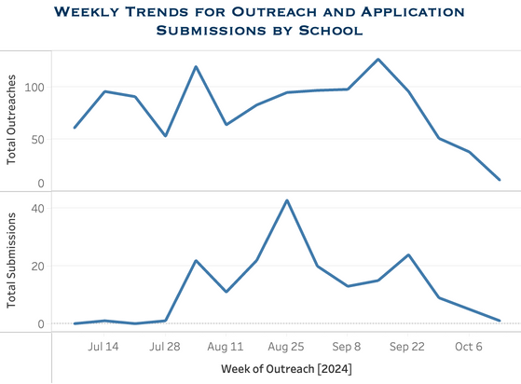
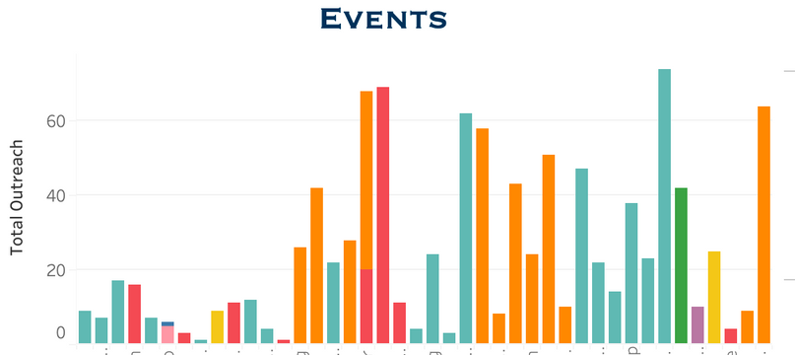
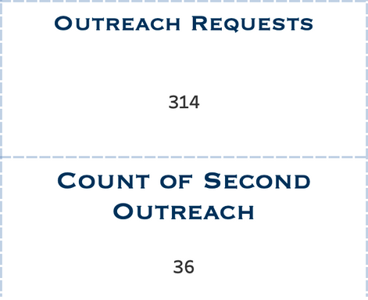
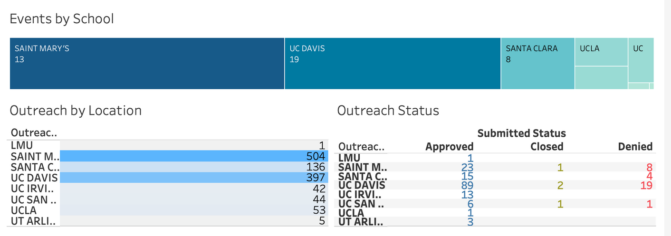
DASHBOARD-DRIVEN INSIGHTS
11

Slide 11
DASHBOARD-DRIVEN INSIGHTS
12

Slide 12
DASHBOARD-DRIVEN INSIGHTS
13

Slide 13
DASHBOARD-DRIVEN INSIGHTS
14

Slide 14
DASHBOARD-DRIVEN INSIGHTS
15

Slide 15
CONCLUSION
KEY ACHIEVEMENTS:
DEVELOPED A STREAMLINED APPROACH TO TRACKING EVENT SUCCESS WITH AN INTUITIVE, USER-FRIENDLY UI ACCESSIBLE TO ALL USERS.
ENABLED REAL-TIME DECISION-MAKING THROUGH DYNAMIC DASHBOARDS AND HIGHLIGHTED THE IMPACT OF OUTREACH EFFORTS ON UCU'S GROWTH.
16

Slide 16
PROJECT OUTCOMES
STREAMLINED DATA PROCESSING: AUTOMATED WORKFLOWS SIGNIFICANTLY REDUCED MANUAL EFFORT AND ERRORS.
DYNAMIC DASHBOARDS: REAL-TIME INSIGHTS ENABLE INFORMED DECISION-MAKING AND PERFORMANCE TRACKING.
INTEGRATED DATASETS: Consolidated four fragmented data sources into a unified, cohesive dataset.
ENHANCED OUTREACH ANALYSIS: IMPROVED UNDERSTANDING OF REPEATED OUTREACH EFFORTS AND CUSTOMER ENGAGEMENT.
THIS PROJECT’S OUTCOMES PROVIDES UCU WITH A SCALABLE, INTUITIVE APPROACH TO MONITOR EVENT SUCCESS AND DRIVE ORGANIZATIONAL GROWTH EFFECTIVELY.
17

Slide 17

RECOMMENDATIONS
OUTREACH DATE SHOULD BE REQUIRED
Email should be required
Growth Officer should be standardized across all the files
Event Name, Event Type, On which date they attended the event should be included and required on Outreach File
School should be standardized across all the files
18

Slide 18

FUTURE WORK
CUSTOMER RETENTION (POST-EVENT ENGAGEMENT ANALYSIS)
PREDICTIVE ANALYTICS
ROI AND ATTRIBUTION ANALYSIS
GAMIFICATION METRICS
GEOSPATIAL COST ANALYSIS
EVENT CUSTOMIZATION SUGGESTIONS
19

Slide 19
THANK YOU
20

